Slide 1
Churn Analysis

Slide 2
Purpose Statement
The collected data is the data of a telecom company with multiple attributes. Our goal is to identify the properties that contribute towards the high churn rate of the customers, during a specific time. By having insights into the churned customers, we can identify the customers who are most likely to churn soon and avoid such situations by taking precautionary steps.

Slide 3
Data Understanding

Slide 4
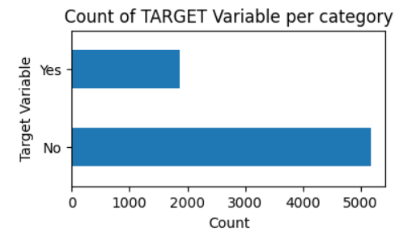
Target variable
Data is highly imbalanced the churn ratio is almost 73:27.
So, we will analyze how the churn rate is dependent on other features of the data.

Slide 5
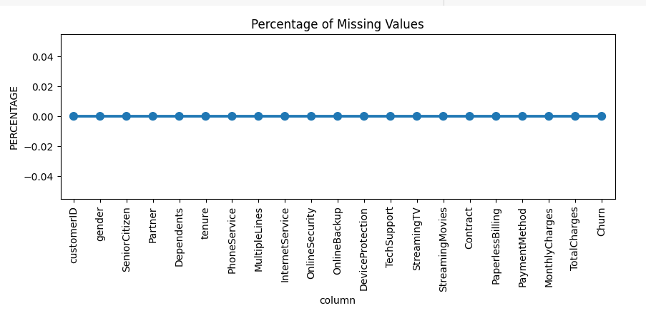
Missing Data - Initial Intuition
Initially, we don't have any missing data.
For features with fewer missing values- can use regression to predict the missing values or fill with the mean of the values present, depending on the feature.
For features with a very high number of missing values- it is better to drop those columns as they give very little insight into the analysis.
As there's no thumb rule on what criteria we delete the columns with a high number of missing values, generally you can delete the columns if you have more than 30-40% of missing values.

Slide 6
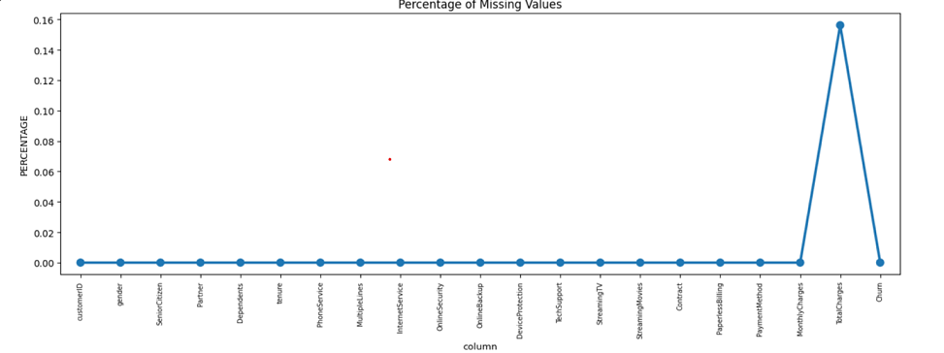
Initial Findings
Upon checking the data types I found that, while loading the data from the CSV file the datatype of Total charges became Object so we will need to change it, to Numeric
After converting the data to correct datatypes, TotalCharges column had 11 missing values.

Slide 7
Missing Value Treatment
As a treatment, Since the % of these records compared to the total dataset is very low i.e., 0.15%, it is safe to ignore them from further processing.
Furthermore, as the tenure was distributed in a range of 0-72, it was difficult to create graphs. As a solution, divide customers into bins based on tenure e.g., for tenure < 12 months: assign a tenure group of 1-12, for tenure between 1 to 2 Yrs, a tenure group of 13-24; so on...

Slide 8
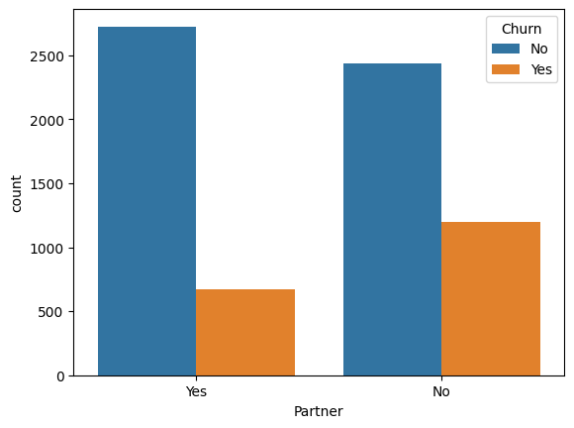
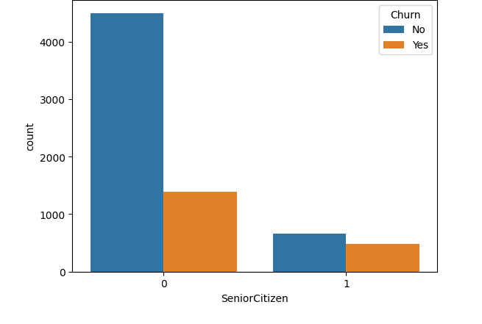
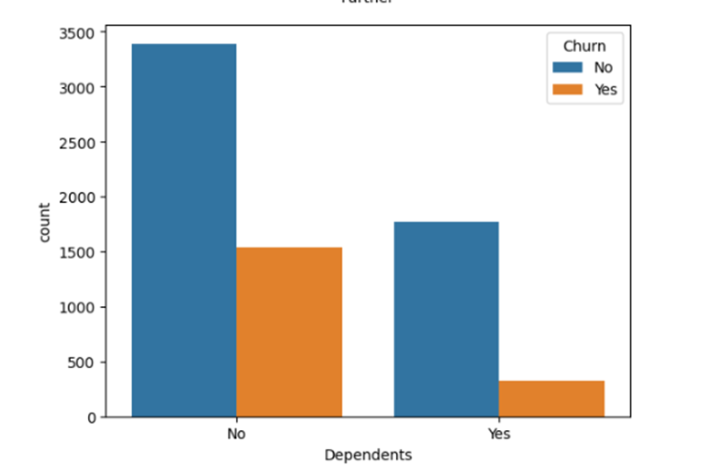
Univariate Analysis
Findings
Customers who does not have partner and dependents are more likely to Churn
Senior Citizens are high Churners

Slide 9
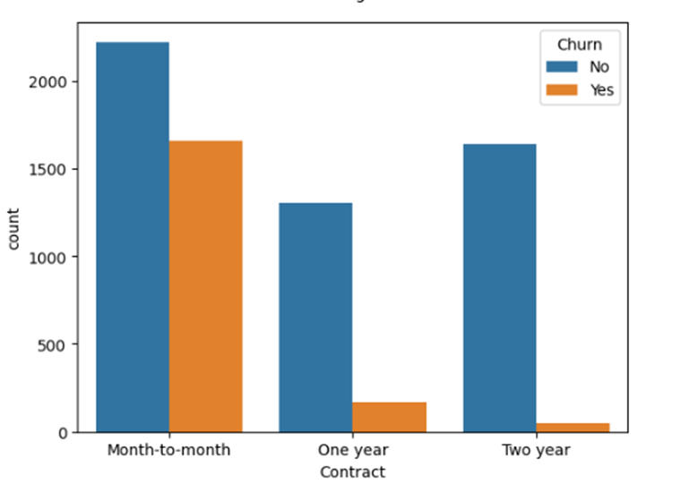
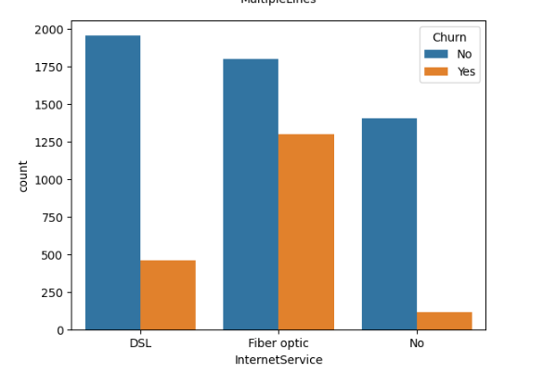
Univariate Analysis
Findings
Customer with Month-to-Month contract are at high risk to leave the company.
Customers who use fiber optics as an internet service are more likely to churn.

Slide 10
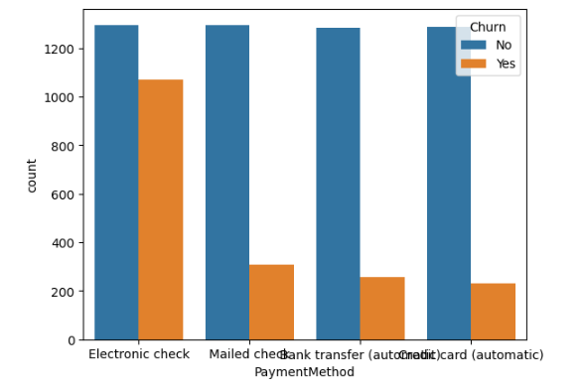
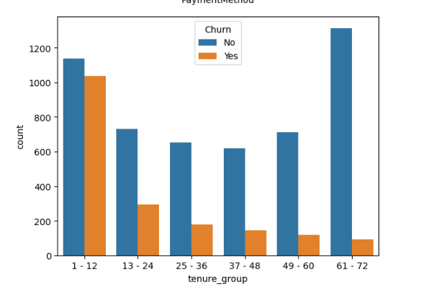
Univariate Analysis
Findings
Customers who opted to pay bills through electronic checks are high churners.
Customers fall in tenure group1-12 are more likely to churn.

Slide 11
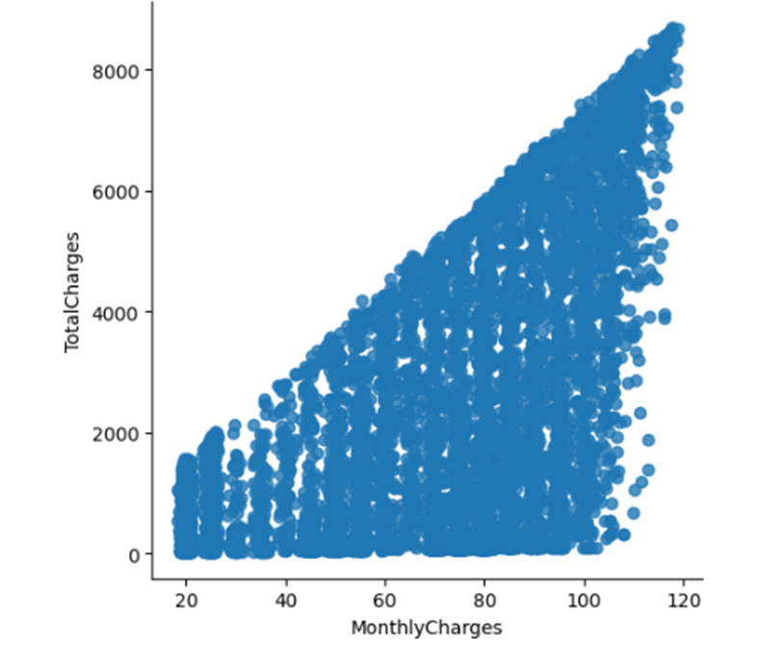
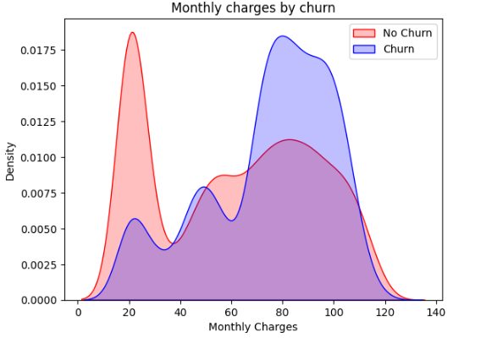
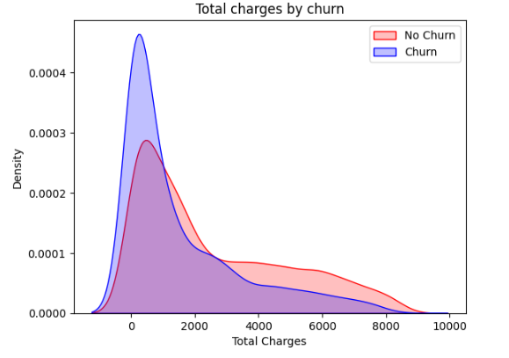
Relationship between Monthly and Total Charges
Findings
Total Charges increase as Monthly Charges increase.
Churn is high when Monthly Charges are high.
However, if we combine the insights of 3 parameters i.e., Tenure, Monthly Charges & Total Charges then the picture is bit clear :- Higher Monthly Charge at lower tenure results into lower Total Charge. Hence, all these 3 factors viz Higher Monthly Charge, Lower tenure and Lower Total Charge are linked to High Churn.

Slide 12
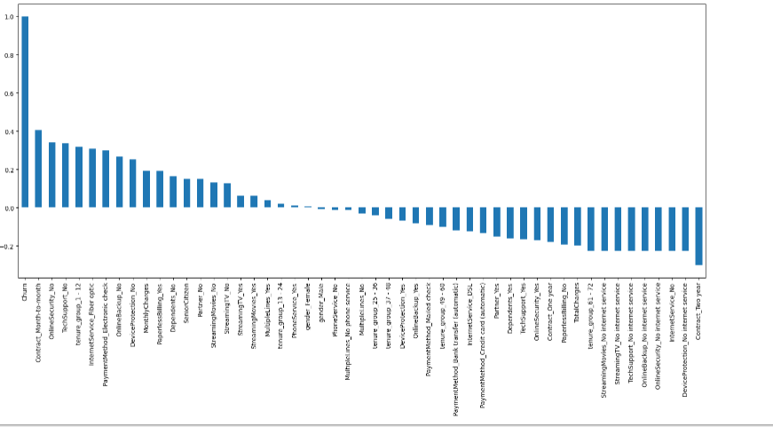
Correlation of all Predictors with Churn
HIGH Churn seen in case of Month-to-month contracts, No online security, No Tech support, First year of subscription and Fiber Optics Internet
LOW Churn is seeming in case of Long-term contracts, Subscriptions without internet service and The customers engaged for 5+ years
Factors like Gender, Availability of PhoneService and # of multiple lines have almost NO impact on Churn

Slide 13
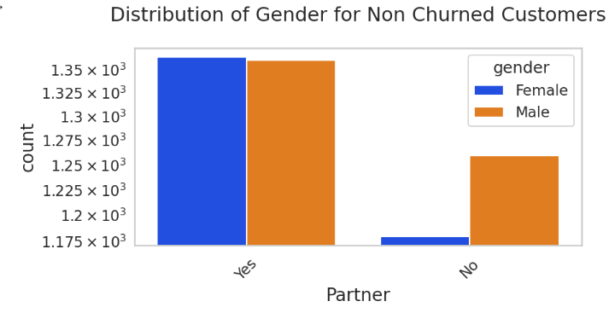
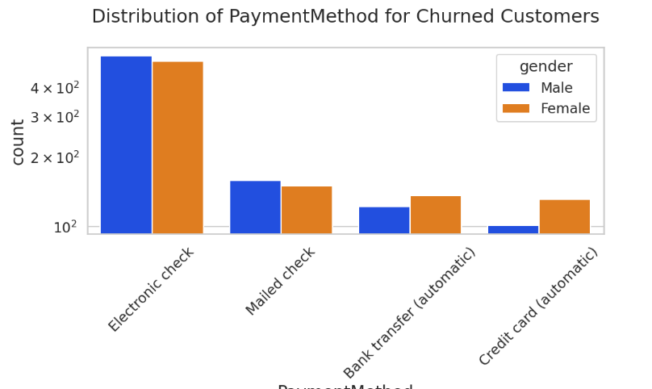
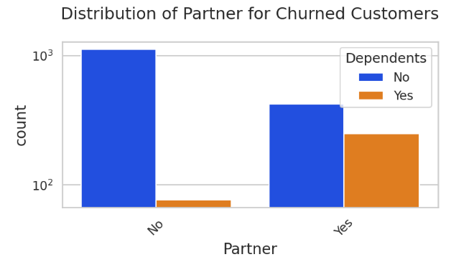
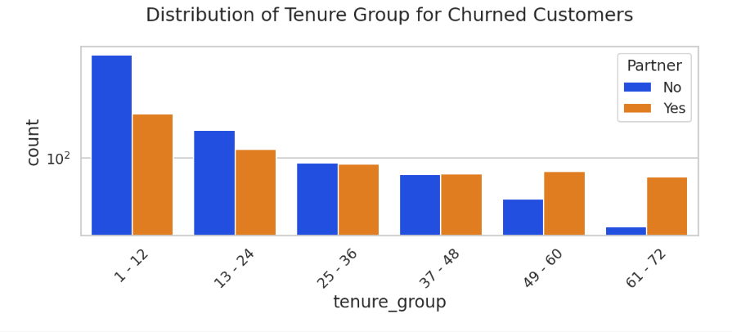
Bivariate Analysis

Slide 14
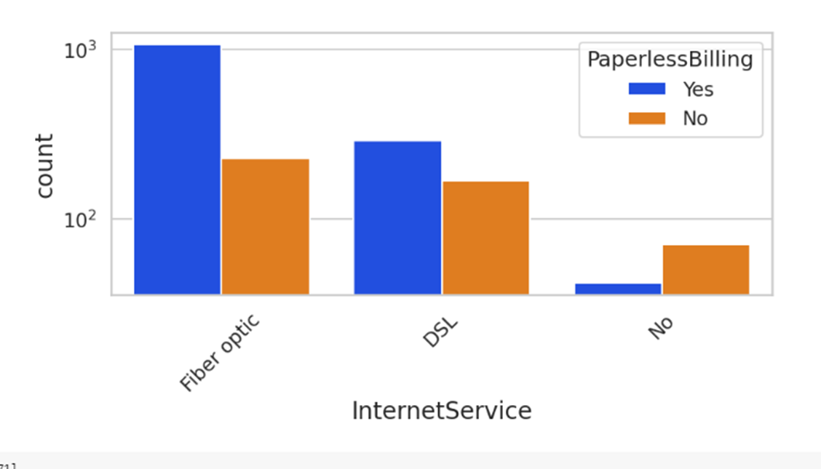
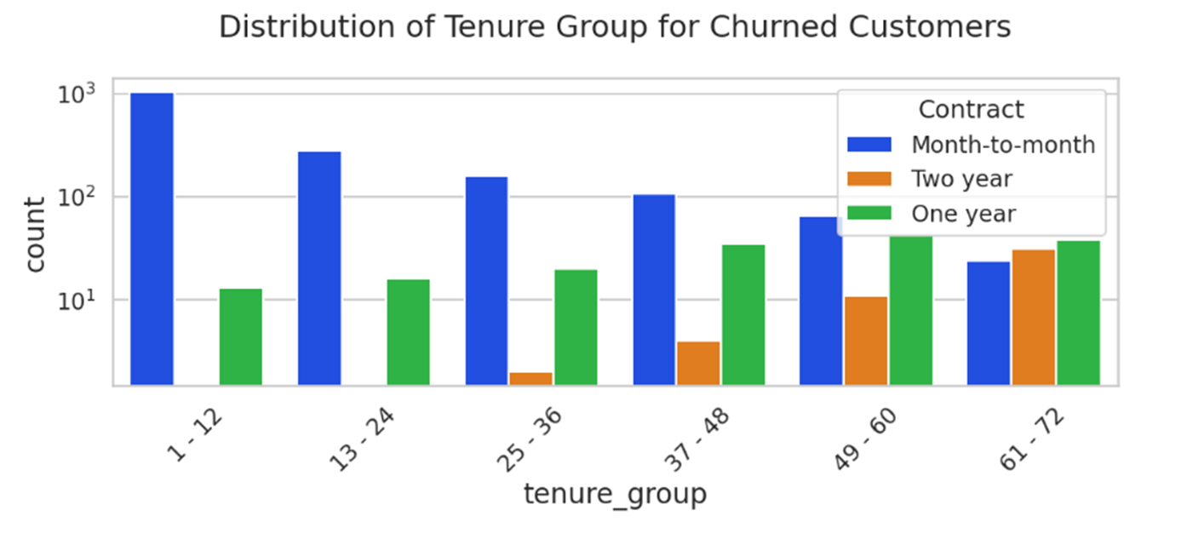
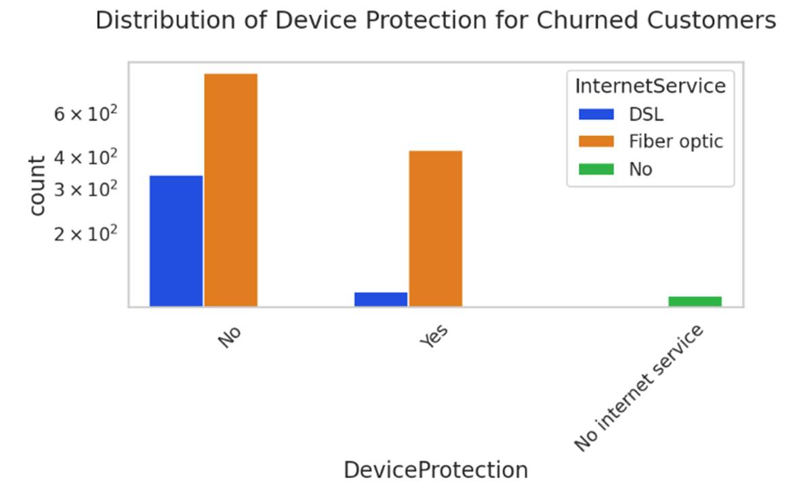
Bivariate Analysis

Slide 15
Conclusion
[73]
0s
Male with partner are high churners
Female using cc as payment method are high churners
Customers with no dependents and no partner are high churners
Customers who have partner and tenure is 60-72 are high churners
People using fiber optics and paperless billing are churners
Month to Month contractors are more likely to churn within tenure 1-12
People with Fiber optics internet service and have device protection are more likely to churn

